Slide 1

Jelly Bean Airlines
A Comprehensive Analysis of Aircraft Fatality Risk in the U.S.
March 8, 2024

Slide 2



Jelly Bean Airlines
Corporate Strategy - Data Science Team
Name: Danny Fox
Role: Github Lead
Contact: DBAfox
Name: Sam Choe
Role: Presentation/Tableau Lead
Contact: schoe4208
Name: Travis Clark
Role: Tech Lead
Contact: TravisClark1432

Slide 3
Agenda
Business Problem
Data Overview
Analysis
Recommendations
Future Steps

Slide 4


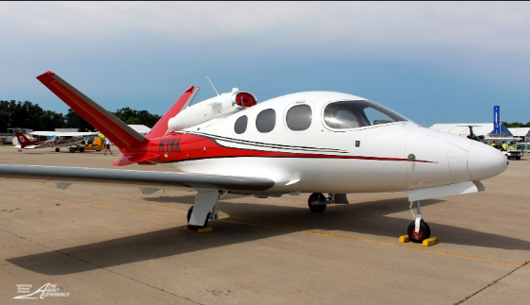
Main Finding
Operating BEECH or AERO private aircrafts in the U.S. Mainland reduces fatality rate by up to ~86%
BEECH
Fatality Rate Is Reduced By ~86%
AERO

Slide 5

Business Problem

Slide 6
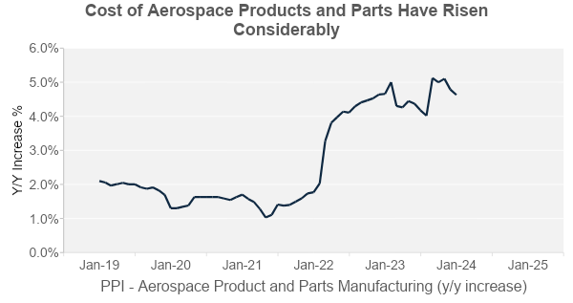
Purchasing Aircrafts Have Become More Expensive…
More recently, inflation and supply chain issues have driven up costs.
Source: Federal Reserve Economic Data (Producer Price Index by Industry: Aerospace Product and Parts Manufacturing, Index Jun 1985=100, Monthly, Not Seasonally Adjusted)
Business Problem
Data Overview
Analysis
Recommendations
Future Steps

Slide 7
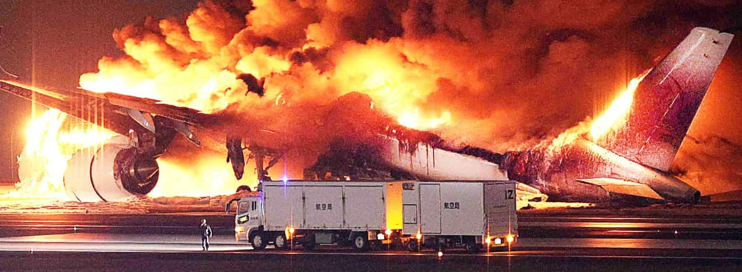
… We Don’t Want Our Investment to Come Crashing Down
Business Problem
Data Overview
Analysis
Recommendations
Future Steps

Slide 8
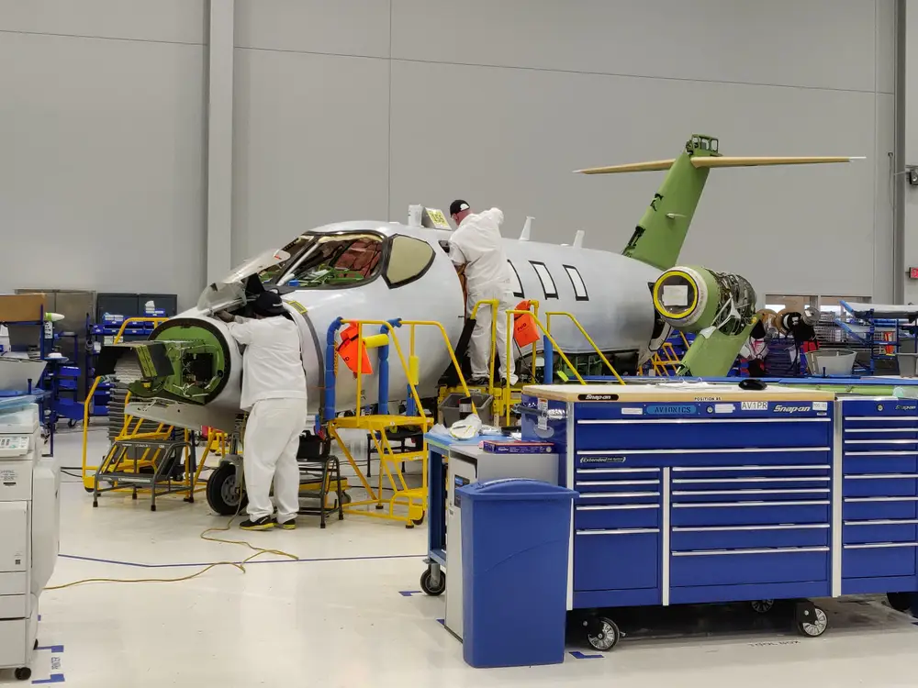
Data Overview

Slide 9
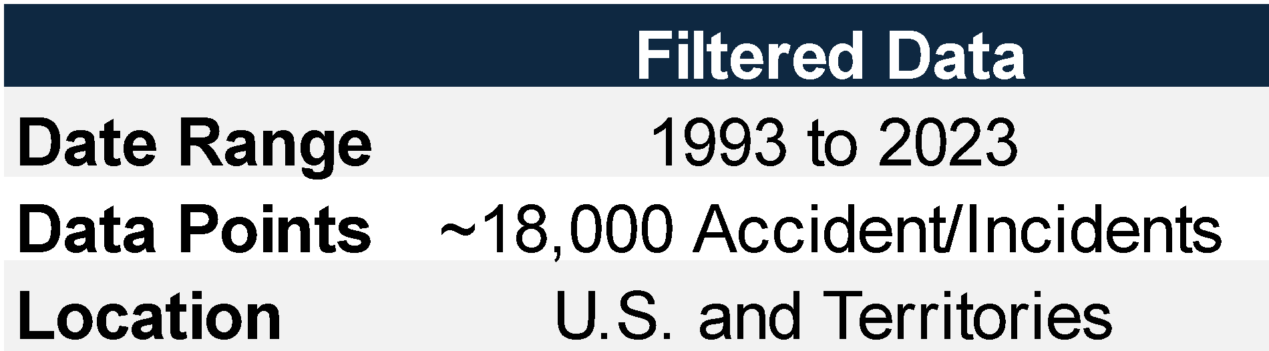
Our Data Filtering Process Was Intensive
Data Source: Our Accidents Data Came From the NTSB Database
Data Limitations: No successful flight data and the international dataset was insufficient.
Business Problem
Data Overview
Analysis
Recommendations
Future Steps

Slide 10
We Defined a Unifying Risk Metric
Fatality Rate
Total Fatal Count
(Total Accidents & Incidents)
This helped us have a standardized risk metric to compare risk across the 3-Level Analysis we completed.
Business Problem
Data Overview
Analysis
Recommendations
Future Steps

Slide 11
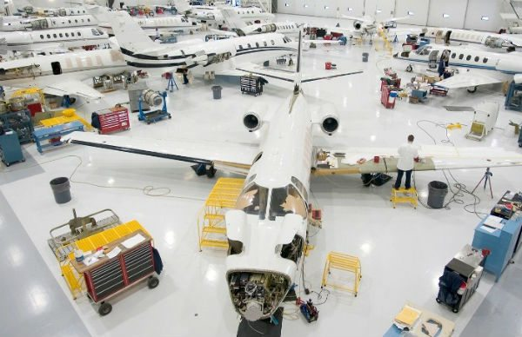
Analysis

Slide 12
We Asked the Following Questions In Our Analysis
Level 1
Focus More on Commercial or Private to Lower Risk?
Level 2
What Private Aircraft Make Lowers Risk?
Level 3
What parts of the U.S. should be serviced?
Business Problem
Data Overview
Analysis
Recommendations
Future Steps

Slide 13
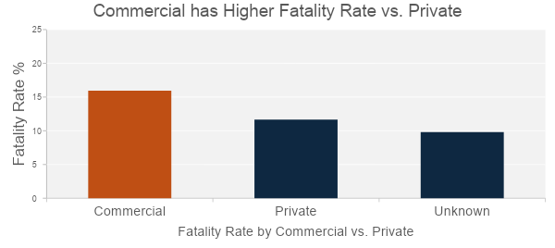
Level 1: Focus More on Private Flights
Going Private seems like the safer strategic option
This reduces fatality rate by ~27%
Business Problem
Data Overview
Analysis
Recommendations
Future Steps

Slide 14
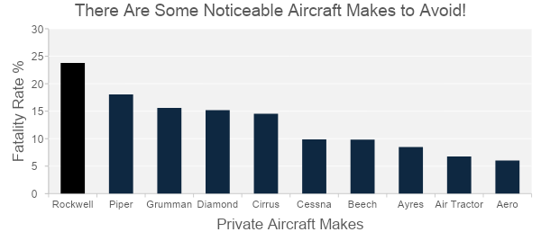
Level 2: Investigating Aircraft Makes
At first glance, we want to avoid some Aircraft Makes
To improve on our findings, we rerun the analysis by also considering Weather Patterns
Business Problem
Data Overview
Analysis
Recommendations
Future Steps

Slide 15
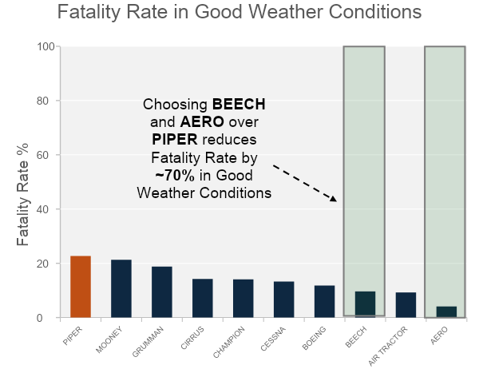
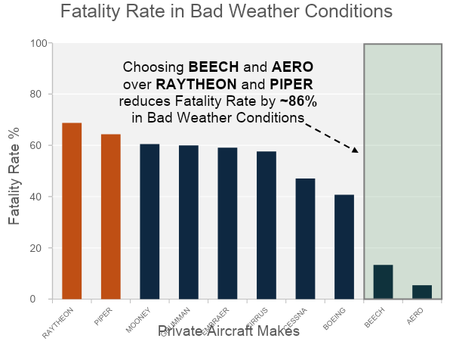
Level 2: We Recommend BEECH and AERO
Business Problem
Data Overview
Analysis
Recommendations
Future Steps

Slide 16
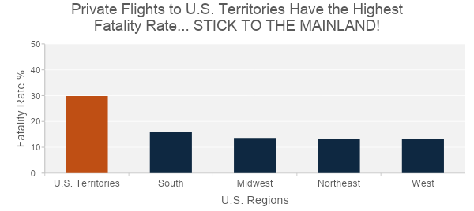
Level 3: Stick With the Heart of America… The Mainland
Service U.S. Mainland
Reduce the Fatality Rate by up to ~53%
Business Problem
Data Overview
Analysis
Recommendations
Future Steps

Slide 17

Recommendations

Slide 18
To Prevent Negative ROI scenarios, We Recommend…
Private Flights reduces risk of fatality by ~27%
Investing in BEECH or AERO reduces risk of fatality by up to ~86%
Servicing Just Mainland U.S. reduces risk of fatality by up to ~53%
Business Problem
Data Overview
Analysis
Recommendations
Future Steps

Slide 19

Future Steps

Slide 20
What Needs to Be Done Next?
Run Secondary Analysis Incorporating Successful Flights Data
Financial Analysis of Aircraft Operations & Maintenance Costs
Go More Granular with Model Types by Makes
Business Problem
Data Overview
Analysis
Recommendations
Future Steps

Slide 21

Questions?

